Slide 1
DATABASE MANAGEMENT SYSTEM MCA
I Semester
AUG 2022
Database System Concepts
Abraham Silberschatz, Henry F. Korth, S. Sudarshan

Slide 2
Entity-Relationship Model
Notes:
Sample CMR10 font- who supply every red part.
7. Find the sids of suppliers who

Slide 3
ER-Model
Used for Conceptual Modeling of the Database schema.
Meant for Human comprehension.
To tell End User, what is understood about their Domain.
High-level database design without implementation details.
DBMS independent.
Building Blocks: Entity, Attribute and Relationship
Notes:
Logical representation of database.
Used

Slide 4
Entity
An entity is an object that exists in the real world and is distinguishable from other objects.
In real world, an entity has a set of properties and the values for those properties identify it.
Example: Faculty, Student, company, event, plant ,Course, Account
Properties of Student –RegNo, Name, Course, Phone.
Values of these property-(180370123,’Rajesh’,’MCA’,9876999756) is an entity

Slide 5
Entity Sets
An entity set is a set of entities of the same type that share the same properties.
Example: set of all students who share same properties.
{(200970123,’Rajesh’,’MCA’,9876999756) ,
(200968124,’Ramesh’,’DSE’,8876999756) , ……..}
Example:
Student entity set –Collection of all student entities.
Faculty entity set –Collection all faculties in a college
Notes:
Meant for Human comprehension

Slide 6
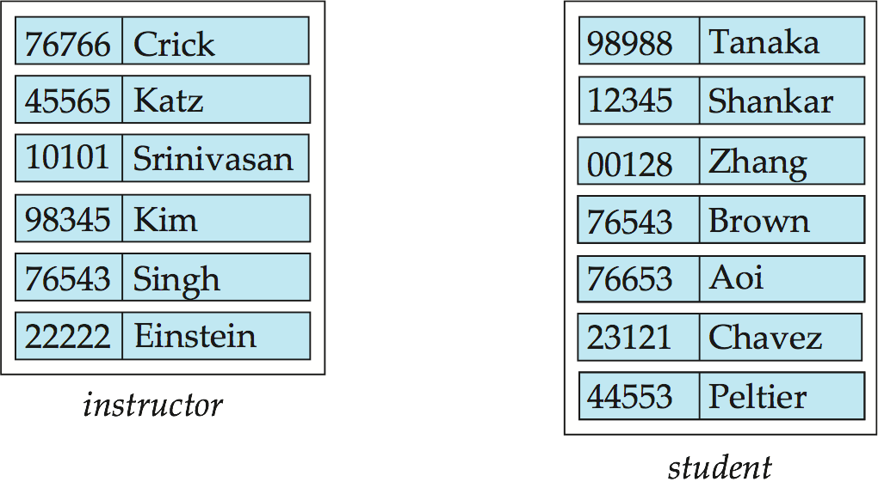
Entity Sets- instructor and student
ID
name
ID
name
Instructor={ (76766,Crick),45565,Katz),(10101,Srinivasan),…(22222, Einstein) }
Student={ (98988,Tanaka),(12345,Shankar),(00128,Zhang),….(44553,Peltier) }
PRIMARY KEY: Each entity has one or more combination attributes can be used to identify each entity uniquely.
The ID attribute is used to identify instructors uniquely.
Notes:
Each entity has one or more combination attributes can be used to identify each entity uniquely.
The ID attribute is used to identify instructors uniquely, since there may
be more than one instructor with the same name.

Slide 7
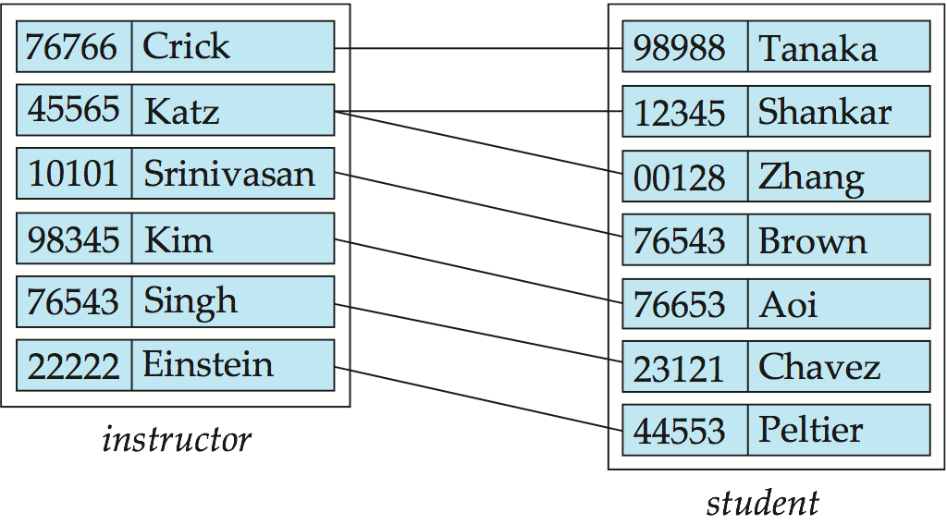
Relationship Sets
Assume that – we want to model the information such as – Crick is advisor for Tanaka ; Katz is advisor for Shankar & Zhang ; Srinivasan is advisor for Brown; and so on.
In other words, we are interested in representing information that Some instructor will be advisor for Some Student/Students(Association between Instructor & Student).
Relationship set ={ (76766,Crick , 98988,Tanaka) ,(45565,Katz,12345,Shankar), (45565,Katz,00128,Zhang),(10101,Srinivasan),…(22222, Einstein,44553,Peltier) }
Notes:
Assume that – we want to model the information such as – Crick is advisor for Tanaka ;Katz is advisor for Shankar, Zhang; Srinivasan is advisor for Brown; and so on.
In other words, we are interested in representing information that Some instructor will be advisor for Some Student/Students(Association between Instructor & Student).This Association is represented as Relationship between entities and such a group of relationships is Relationship set.
In the example -Crick is advisor for Tanaka is a relationship and a set (group) containing relationships -Crick is advisor for Tanaka ;Katz is advisor for Shankar, Zhang; Srinivasan is advisor for Brown; and so on is Relationship set.
Relationship set ={ (76766,Crick - 98988,Tanaka) ,(45565,Katz- 12345,Shankar), (45565,Katz-00128,Zhang)(10101,Srinivasan),…(22222, Einstein-44553,Peltier) }
To Model this kind of association among entities ,we use Realtionship and Realtionship set concept in ER Model

Slide 8
Relationship Sets
Consider formal definition of Relationship set.
A relationship is an association among several entities
Example: (22222 ,Einstein) advisor (44553 ,Peltier) instructor entity relationship set student entity
Collection of such relationship is Relationship set
A relationship set is a mathematical relation among n ≥ 2 entities, each taken from entity sets E₁,E₂,..E_{n}.
{(e₁, e₂, … e_{n}) | e₁ ∈ E₁, e₂ ∈ E₂, …, e_{n} ∈ E_{n}} where (e₁, e₂, …, e_{n}) is a relationship
i.e. (44553 ,Peltier, 22222, Einstein) a relationship set element(instance)
Every instance in a entity set is distinguishable from other entities using primary key , in the same way every relationship in a relationship set is distinguishable.
Primary Key of relationship set is – PK(E₁) U PK(E₂)…. PK(E_{n})
Example:
(44553,22222) ∈ advisor.

Slide 9
Relationship Sets (Cont.)
The association between entity sets is referred to as participation.
A relationship instance (ex: (45565,Katz-00128,Zhang)) in an E-R schema represents an association between the named entities (ex: (45565,Katz) an Instructor entity & (00128,Zhang) a Student entity) in the real-world enterprise that is being modeled.
The function that an entity plays in a relationship is called entity’s role.
Relationship set ={ (76766,Crick - 98988,Tanaka) ,(45565,Katz- 12345,Shankar), (45565,Katz-00128,Zhang),…,…(22222, Einstein-44553,Peltier) }

Slide 10
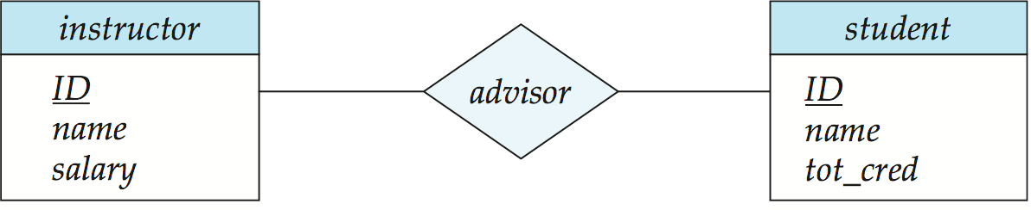
E-R Diagrams
Following is the diagrammatic representation of Relationship( discussed in slide 11) in ER Model
Rectangles represent entity sets.
Diamonds represent relationship set.
Attributes listed inside entity rectangle.
Underline indicates primary key attributes.
Notes:
Note: ER diagram notation in 6th edition of Database System Concepts changed from earlier editions; now based on UML class diagram notation with some modifications.

Slide 11
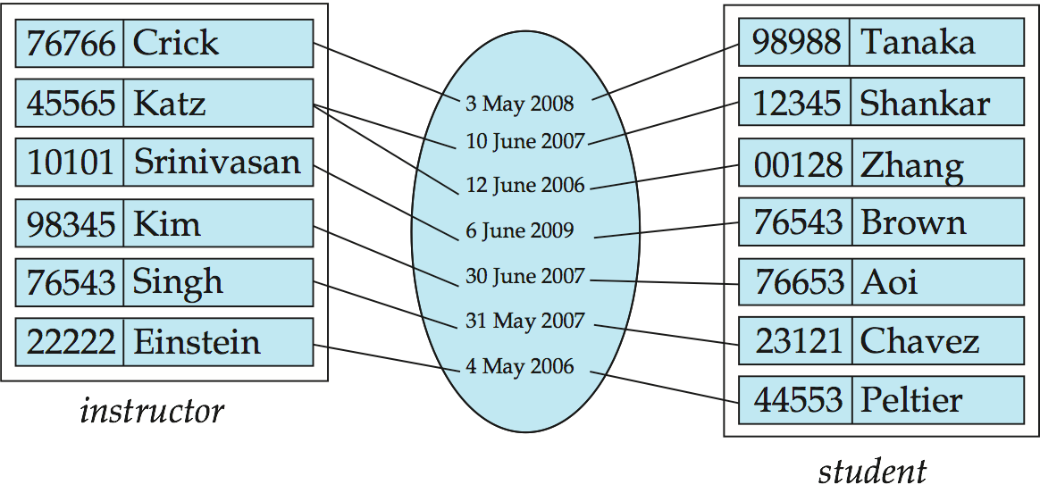
Relationship Sets (Cont.)
A relationship may also have attributes called descriptive attributes.
Assume that we want to store information that –An Instructor I became an Advisor to Student S on the date D.
Ex: (76766,Crick) became Advisor to a Student (98988,Tanaka) on 3rd May 2008.
3rd May 2008 date is property of neither Instructor nor Student, but it has meaning when referred w.r.t Advisor relation ship between Instructor & Student.
Notes:
Assume that we want to store information that –An Instructor I became an Advisor to Student S on the date D
Ex: (76766,Crick) became Advisor to a Student (98988,Tanaka) on 3rd May 2008.
3rd May 2008 date is property on neither Instructor nor Student, but it has meaning when referred w.r.t Advisor relation ship between Instructor & Student.

Slide 12
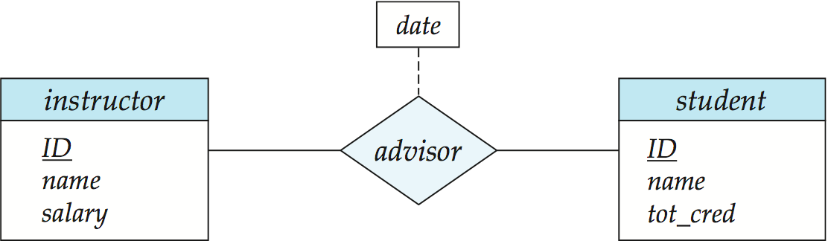
Relationship Sets with Attributes
Date_of_advisor
The design decision of where to place descriptive attributes in such cases—as a relationship or entity attribute—should reflect the characteristics of the enterprise being modeled.
Notes:
If a relationship set has some attributes associated with it, then we enclose the
attributes in a rectangle and link the rectangle with a dashed line to the diamond
representing that relationship set.
we have the date
descriptive attribute attached to the relationship set advisor to specify the date on
which an instructor became the advisor.
In this example association between instructor and Student as meaning when referred with respect to on what date Instructor advising student.
Date when advising done is neither property(attribute) of instructor nor of student. It is the property of association between instructor and Student

Slide 13
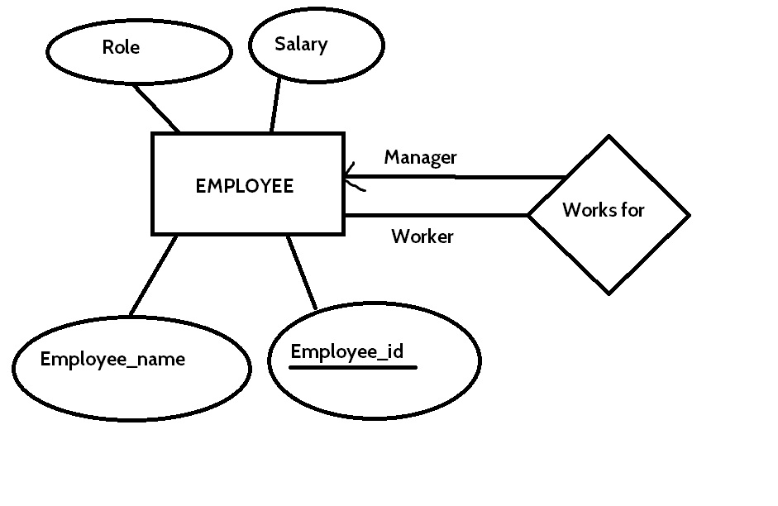
Recursive Relationship set
If the same entity sets participates in a relationship set more than once in different roles-Recursive relationship

Slide 14
Recursive Relationship..
Example: Sample relationship between EMP entities.
Emp_ID | Ename | Job | Salry
100 |  | Clerk
101 |  | Manager
103 |  | S.Clerk
108 |  | Accountant
105 |  | O.Assitant
108 |  | S.Manager
109 |  | R.Manger
(100,..,Clerk,..) is an entity in EMP entity set and is having relationship (association) with another entity (101,..,Manger,..) in the same Entity set( i.e. EMP)
Notes:
(100,..,Clerk,..) is an entity in EMP entity set and is having relationship (association) with another entity (101,..,Manger,..) in the same Entity set( i.e. EMP)

Slide 15
Recursive Relationship when converted into schema, it looks as below-
ManagerNo is foreign key Referencing EMP which models the recursive relationship shown in ER diagram.
We will study, how ER diagram in converted into schema(set of Tables) later in this chapter.
Emp_ID | Ename | Job | Salry | ManagerNo
100 |  | Clerk |  | 101
101 |  | Manager
103 |  | S.Clerk |  | 101
108 |  | Accountant |  | 109
105 |  | O.Assitant
108 |  | S.Manager
109 |  | R.Manger |  | 109
Notes:
ManagerTo is foreign key which models relationship shown in ER diagram

Slide 16
Attributes
An entity is represented by a set of attributes, that is descriptive properties possessed by all members of an entity set.
Example:
instructor = (ID, name, street, city, salary ) course= (course_id, title, credits)
Domain – the set of permitted values for each attribute
Attribute types:
Simple and composite attributes.
Simple- having atomic or indivisible values.
Example: Department_Name , State, city
Composite- having several components in the value.
Example: Contact_number attribute further having components- STDCode and Phone Number
Notes:
Assume that we have RollNo attribute and we are inserting Roll numbers to students and our rules for roll number is they have to be 3 digits starting from 100 to 999. A Rollo can take any value from 100 to 999
i.e the set RollNo_Domain={100,101,102,……901,…998,999} is the domain of RollNo.
Any value out side this range such as 99,50, 1000, 1999 etc are invalid values for RollNo attribute.
Assume that we have Marks attribute and we are inserting valid Marks value to Marks and our rules are- Marks must be positive in the range 0 to 100.
i.e Marks_domain={0,1,2, ….99,100} is the set of all valid values for Marks Attribute.
Any value outside this range such as -5 or 101 etc are invalid values for Marks attribute.

Slide 17
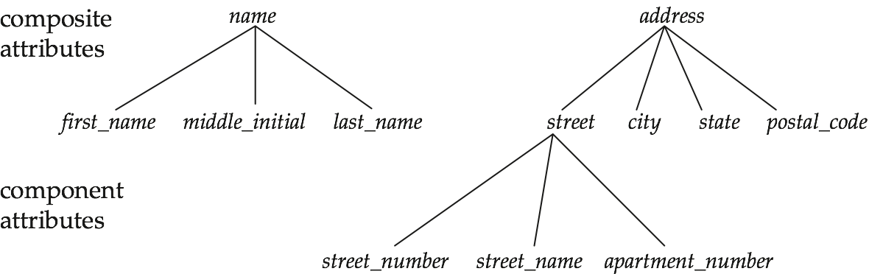
Composite Attributes
Single-valued and multivalued attributes
Single- having only one value rather than a set of values.
Example: Birth_Place
Multivalued - having a set of values rather than a single value
Example: phone_numbers ,Emails of a person , Degrees acquired by a faculty
Derived attributes
Can be computed from other attributes
Example: Age, given date_of_birth

Slide 18
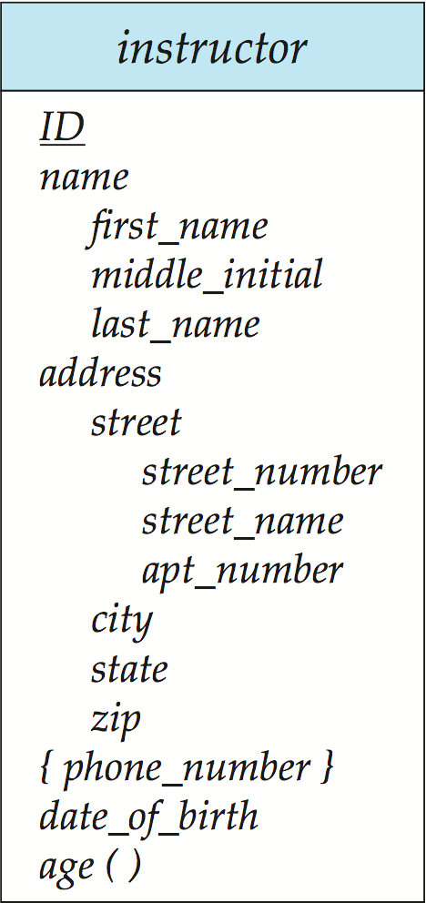
Entity With Composite, Multivalued, and Derived Attributes
composite
multivalued
derived

Slide 19
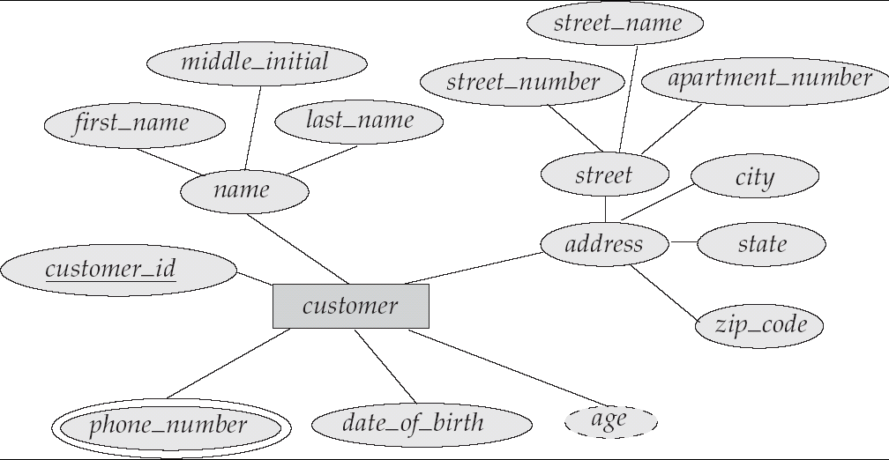
Entity With Composite, Multivalued, and Derived Attributes
In 4th Edition

Slide 20
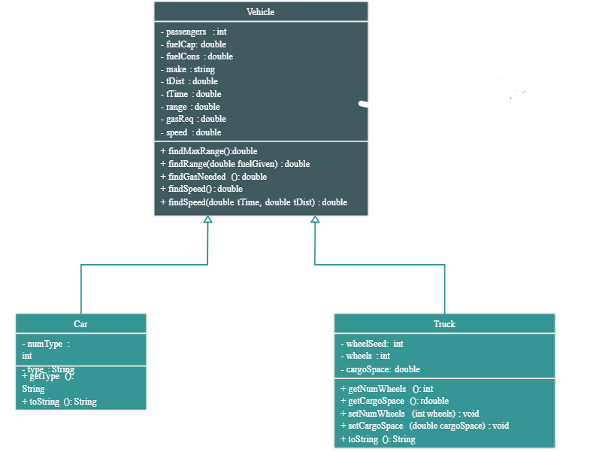
Similar to UML- Class Diagram

Slide 21
Degree of a relationship
•Degree: the number of participating entity sets in a relationship.
•Degree 2: binary
involve two entity sets
•Degree 3: ternary
•Degree n: n-ary
•Binary relationships are very common and widely used.

Slide 22
Mapping Cardinality Constraints
Express the number of entities to which another entity can be associated via a relationship set.
Most useful in describing binary relationship sets.
For a binary relationship set the mapping cardinality must be one of the following types:
One to one
One to many
Many to one
Many to many

Slide 23
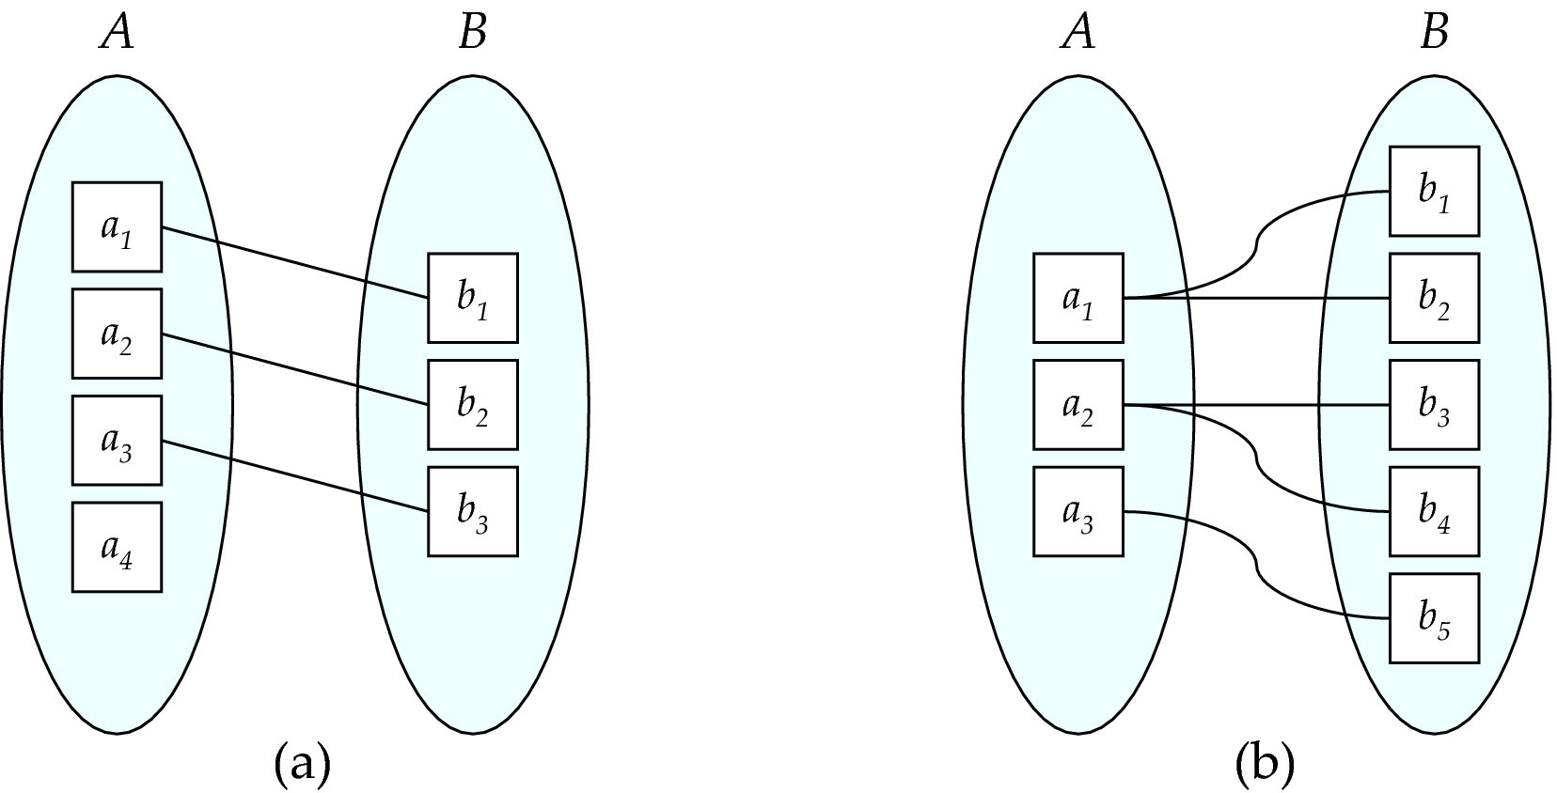
Mapping Cardinalities
One to one
One to many
Note: Some elements in A and B may not be mapped to any
elements in the other set

Slide 24
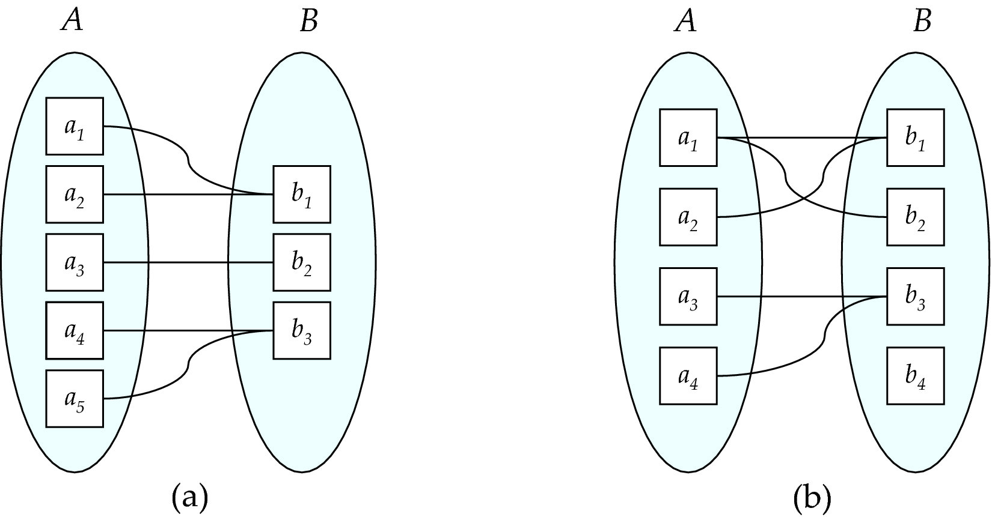
Mapping Cardinalities
Many to one
Many to many
Note: Some elements in A and B may not be mapped to any
elements in the other set

Slide 25
Cardinality Constraints
We express cardinality constraints by drawing either a directed line (→), signifying “one,” or an undirected line (—), signifying “many,” between the relationship set and the entity set.

Slide 26
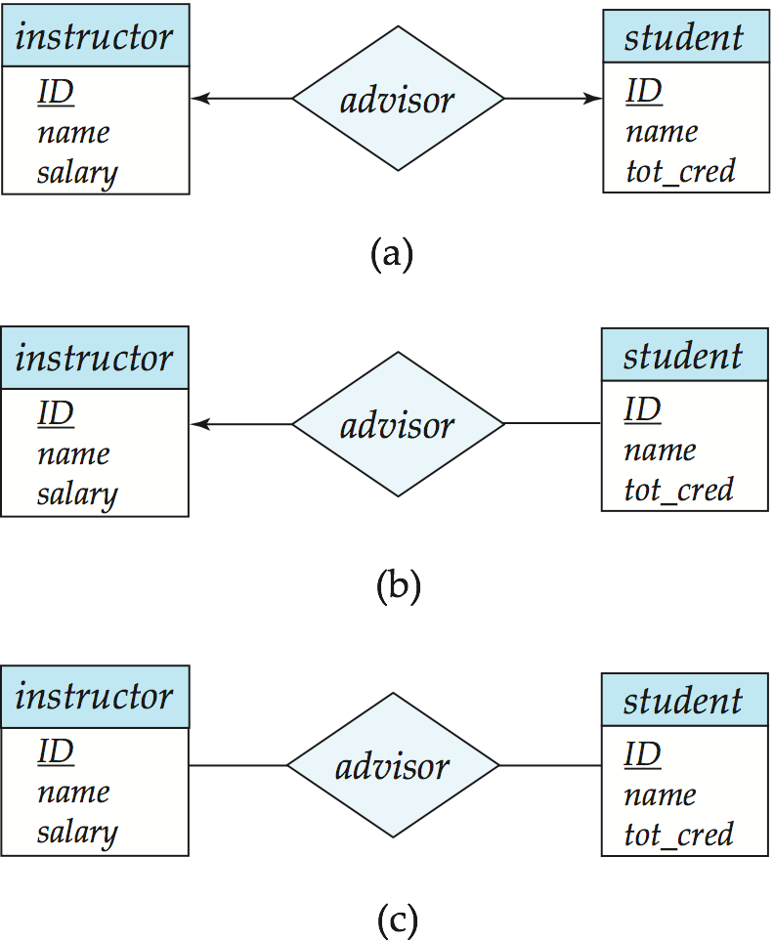
One-to-One Relationship
one-to-one relationship between an instructor and a student
“an instructor is associated with at most one student via advisor “
and “a student is associated with at most one instructor via advisor”

Slide 27
Example one-one
Head_Of_Institute
Head_Name | Experience | Qualification
Rajesh | 28 | Mtech PhD
Ravi | 30 | MSc PhD
Blake | 19 | MS PhD
Mukhesk | 25 | Mtech PhD
Institute
Institute Name | Location
ABC Tech | Mangalore
AAA Engg College | Bangalore
BBB Technology | Hyderabad
VTU | Belgaum
A sample one-to-one relationship between an Institute and a Head_Of_Institute
1 Institute will have only 1 Head of Institute –Therefore exactly one Head_Of_Institute entity is associated with exactly one Institute Entity

Slide 28
One-to-Many Relationship
one-to-many relationship between an instructor and a student
an instructor is associated with several (including 0) students via advisor relationship.
a student is associated with at most one instructor via advisor,

Slide 29
Example one- Many
Policy
Customers
Policy_No | Date_of_Purchase | Premium | No_of_Premium
LIC101 | 10-10-2001 | 4000 | 40
LIC102 | 1-1-1990 | 5000 | 30
LIC107 | 2-5-2012 | 7000 | 20
LIC102 | 2-9-2012 | 7000 | 25
LIC105 | 10-4-2001 | 8000 | 40
LIC202 | 2-3-2003 | 9000 | 30
LIC321 | 2-5-1998 | 3000 | 25
LIC312 | 4-4-2001 | 4000 | 28
LIC383 | 9-1-2004 | 5000 | 15
CustID | Name | City | PAN_NO
C101 | Rajesh | Manipal | ABC1028
C102 | Ravi | Mangalore | AFC1097
C103 | Blake | Bangalore | BSD2013
C104 | Mukhesk | Udupi | RES2001
C105 | Ram | Udupi | FGU7629
a sample one-to-many relationship between an Customers and a Policy
1 Customer may take 1 or More LIC policies
Customers
Custid Name City PAN_NO
Policy
Policy_No Date_of_Purchase Premium No-Of_Premium
Holds

Slide 30
Many-to-One Relationships
In a many-to-one relationship between an instructor and a student,
an instructor is associated with at most one student via advisor,
and a student is associated with several (including 0) instructors via advisor

Slide 31
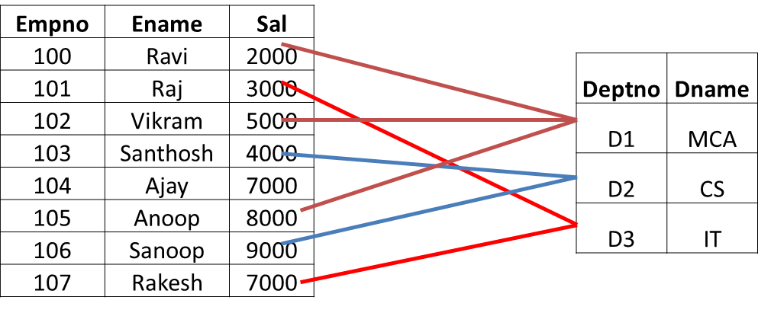
Example Many-one
Employee
Department
A sample many-to-one relationship between an Employee and a Department
More than 1 employees work in 1 Department
Employee
Empno Ename Sal
Works_for
Department
Deptno Dname
One Department entity may be associated with one or more Employee entities
Notes:
Note that in ER diagram , Foreign keys are not shown with any entity, instead it is implicitly indicated by the relationship shown.
In the example above , Deptno of Department is not shown as an attribute in Employee entity to represent relationship. In fact Works_for does that one.
While converting in to tables , this relationship is represented by making Deptno of Department as Foreign key in Employee table.
One Department entity may be associated with one or more employee entities

Slide 32

Many-to-Many Relationship
An instructor is associated with several (possibly 0) students via advisor
A student is associated with several (possibly 0) instructors via advisor
Notes:
Assume that there are different advisors for Technical, Cultural ,Sports activities.
For example-A instructor may be Sports advisor for many Students. Similarly A students may be in two activities-Sports and Cultural, so student is associated with two advisors Instructors corresponding to –Sports and Cultural activities

Slide 33
Example Many - Many
STUDENTS
RegNo | Name | Phone
MCA101 | Rajesh | 124478
MCA102 | Ravi | 344535
MCA103 | Blake | 473456
MCA104 | Mukhesh | 445987
MCA105 | Ram | 896949
MCA106 | Vijay | 800543
SUBJECTS
SubjectID | SubjectName | Credits
S101 | OS | 4
S102 | OT | 3
S103 | INS | 3
S104 | ADBMS | 4
S105 | OOPD | 4
S106 | DS | 4
a many-to-many relationship between an STUDENTS and a SUBJECTS
More than 1 Student can take 1 subject – therefore Many-1
More than 1 Subject cab be take by 1 students – therefore 1-Many
Equivalently
Multiple students can take Multiple Subjects. Therefore Many-Many
STUDENTS
RegNo
Name
Phone
takes
SUBJECTS
SubjectID
SubjectName Credits
Notes:
Note that in ER diagram , Foreign keys are not shown with any entity, instead it is implicitly indicated by the relationship shown.
In the example above , a relation is created for takes relationship as - takes(RegNo,SubjectId)

Slide 34
Example- Design ER Model
Consider the following data requirement of an Institute. Assume that we want model the data requirements using ER modeling.
The Institute is comprised of several departments such as –DSCA, CS, IT etc.. and each department has a Department Number such as D1,D2,.. used to identify each department. Each department has unique name. In every department many employees work. Each employee work in one particular department. Each employee is identified by a unique Employee Number. Other information about each employee we need is employee name and salary.

Slide 35
Empno | Ename | Sal
100 | Ravi | 2000
101 | Raj | 3000
102 | Vikram | 5000
103 | Santhosh | 4000
104 | Ajay | 7000
105 | Anoop | 8000
106 | Sanoop | 9000
107 | Rakesh | 7000
Entity Sets ,Sample Entities and relationship
Deptno | Dname
D1 | MCA
D2 | CS
D3 | IT
A sample Employee and Department entities association is the Relationship set.
and it is modelled as Works _In Relationship below
EMP
Empno
Ename
Sal
Works_In
DEPT
Deptno
Dname
The relationship is having Many-1 Cardinality . An employee can work at most in only 1 department.
Note that If you are adding Deptno as another column in EMP to represent Employee working in a department association, it becomes redundant information as Works_In implicitly represents it. (Same is discussed under heading –Redundant Attributes)

Slide 36
Example- Design ER Model…
Assume that we want model following data requirements of Institute using ER modeling.
The college is comprised of several departments such as –DSCA,CS,IT etc.. and each department has a Department Number such as D1,D2,.. used to identify each department. In every department many employees work. Each employee is identified by a unique Employee Number. Information about each employee we need is employee name and salary.
Extend previous ER diagram with following Data Requirements.
Assume appropriate attributes.
We also want to record information related to the courses offered by each department such as courses names, Number of semesters, Total Credits etc.
For example– IT department offers – Inform. & Tech., Computer & Comm. ; DSCA offers DSE,MCA ;Computer Science offers CS, Info.Security.

Slide 37
Entity Sets ,Sample Entities and relationship
Department Entity Set
Course Entity Set
Course_ID | Course_name | No-Of Sem | Credits
100 | Info & Tech
101 | Comp&Com
102 | Info.Security
103 | Comp Science
104 | DSE
106 | MCA
Deptno | Dname
D1 | DSCA
D2 | CS
D3 | IT
A sample association between Department entities and Course entities
Notes:
Entity Sets ,Sample Entities and relationship Course Entity Set
A sample association between Department entities and Course entities

Slide 38
ER Diagram for the requirements given in slide 34 and 36
EMP
Empno
Ename
Sal
Works_In
DEPT
Deptno
Dname
Offers
Courses
Course_ID
Course_Name
No_of_Sem. Tot_Credits
Notes:
ER Diagram showing requirements of Slide 39

Slide 39
Notation for Expressing More Complex Constraints
Along with Cardinality constraints such as 1-1, 1-M & M-M, Cardinality limits can also be used express participation constraints.
Cardinality limits tells about-
The number of times (Minimum & Maximum) each entity participates in relationships in a relationship set.
A line may have an associated minimum and maximum cardinality, shown in the form l..h
where l is the minimum and h the maximum cardinality
A XXX entity may be associated with a minimum of l₁ number of YYY entities or at the maximum h₁ number of YYY entities through RelationshipXY relationship.
XXX
l₁ . .h₁
RelationshipXY
YYY
Notes:
l_{1 ,} h₁
A XXX entity may be associated with Minimum l₁ number of YYY entities or at the maximum h₁ number of YYY entities.

Slide 40
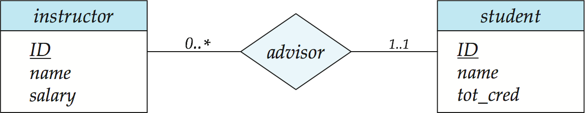
Notation for Expressing More Complex Constraints
Example:
The line between advisor and student has a cardinality constraint of 1..1, meaning the minimum and the maximum cardinality are both 1.
A student entity is associated with max & min 1 instructor entity only.
Means each student must have exactly one advisor.
The limit 0..∗ on the line between Instructor and Advisor indicates that an instructor may be associated with zero or more students.
Means instructor can be advisor for zero or more students.
Notes:
The line between advisor and student has a
cardinality constraint of 1..1, meaning the minimum and the maximum cardinality
are both 1. That is, each student must have exactly one advisor. The limit 0..∗
on the line between advisor and instructor indicates that an instructor can have
zero or more students. Thus, the relationship advisor is one-to-many from instructor
to student, and further the participation of student in advisor is total, implying
that a student must have an advisor.
The relationship advisor is one-to-many from instructor
to student, and further the participation of student in advisor is total, implying
that a student must have an advisor.
It is easy to misinterpret the 0..∗ on the left edge and think that the relationship
advisor is many-to-one frominstructor to student—this is exactly the reverse of the
correct interpretation.

Slide 41
Instructor
Student
ID | Name | Salary
I1
I2
I3
I4
ID | Name | Total_Credit
S1
S2
S3
S4
S5
Advisor
An Instructor may or may not be an Advisor.
Hence Minimum number of Instructor entity that can be associated with student entities through advisor is 0.
An Instructor may be Advisor to any number of Students.
Hence Maximum number of Instructor entity that can be associated with student entities through advisor is *.
0..*
Minimum-0 means every Instructor need not participate in Advisor.
i.e. Partial participation
Each student must have exactly one advisor.
Every student entity is Associated with an Instructor via Advisor Relationship.
Maximum=1 & Minimum=1 Student entity that can participate in Advisor is 1..1
Minimum-1 means every Student must participate in Advisor.
Total participation
Notes:
Instructor
Student
Every student is Associated with an Instructor
An Instructor may or may not be an Advisor, hence Minimum number of Instructor entity that can participate in Advisor is 0

Slide 42
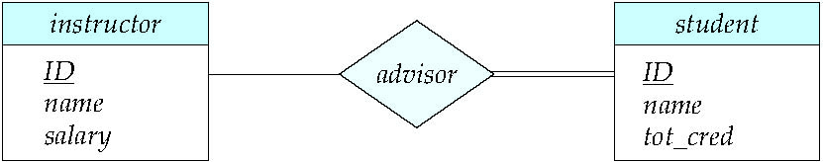
Participation of an Entity Set in a Relationship Set
Total participation (indicated by double line):
every entity in the entity set participates in at least one relationship in the relationship set
E.g., participation of Student in advisor is total
every Student must be associated with instructor

Slide 43
Partial participation:
some entities may not participate in any relationship in the relationship set
Example: participation of instructor in advisor relationship is partial (see next slide)

Slide 44
ID
Name
ID
Name
For an Instructor, being an Advisor is optional –
Therefore Instructor entity participation is PARTIAL)
Note: (45565,Katz) and (98345,Kim) are not participating in advisor relationship
but Every student must have an Advisor –
Therefore Student entity participation is TOTAL.
Notes:
For an Instructor being an Advisor is optional (so an instructor may not be associated with any of the student) -therefore Instructor entity participation is PARTIAL) ,
but every student must have an advisor (so every student entity must be associated with one advisor
i.e. there can not be a student entity not associated with Instructor)- Therefore Student entity participation is TOTAL.

Slide 45
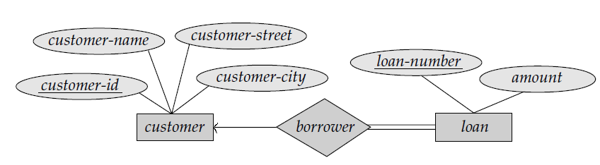
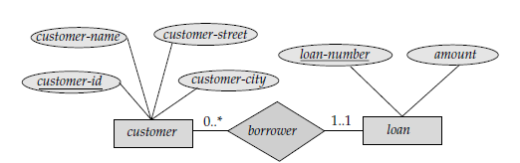
Total and Partial participation …
participation of loan in borrower is total
In loan (entity type), every loan entity has to be associated with 1 or more customers, because a loan can’t be given if there do not exist customer taking loan.
participation of customer in borrower is Partial
In Customer, there may be some customers not taking loan and so do not participate in borrower relationship
Same ER diagram with Cardinality Limit for Participation

Slide 46
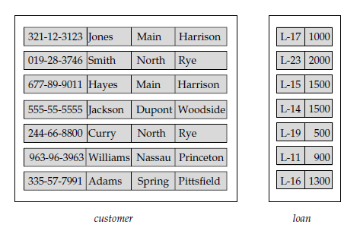
Total and Partial participation …
Partial
Total
Note that Customers- Hayes & Curry haven’t taken any loan , therefore Customer participation is Partial in Borrower relationship.
But, a Loan has to be given to a customer only , so a Loan entity can not exist without being associated with Customer . So Loan participation is Total in Borrower relationship
Notes:
Note that Customers- Hayes & Curry haven’t taken any loan , therefore Customer participation is Partial in Borrower relationship.
But, A Loan has to be given to a customer only , so a Loan entity can not exist without being associated with Customer . So Loan participation is Total

Slide 47
Redundant Attributes
Suppose we have entity sets
instructor, with attributes including dept_name
Department and a relationship
inst_dept relating instructor and department
If we put Attribute dept_name in entity instructor then information (employee works in a department) is redundant since there is an explicit relationship inst_dept which relates instructors to departments
The dept_name attribute replicates information present in the relationship, and dept_name should be removed from instructor
BUT: when converting ER back to tables, in some cases the attribute gets reintroduced.
ID
Name
Dept_name
Budget
Work_for
Instructor
Department
Notes:
Why Foreign Key attribute should not be shown as an attribute of a Entity
consider the entity sets instructor and department:
• The entity set instructor includes the attributes ID, name, dept name, and salary,
with ID forming the primary key.
• The entity set department includes the attributes dept name, building, and budget,
with dept name forming the primary key.
We model the fact that each instructor has an associated department using a
relationship set inst dept relating instructor and department.
The attribute dept name appears in both entity sets. Since it is the primary key
for the entity set department, it is redundant in the entity set instructor and needs
to be removed.
As we shall see later, when we create a relational
schema from the E-R diagram, the attribute dept name in fact gets added to the
relation instructor, but only if each instructor has at most one associated department.
If an instructor has more than one associated department, the relationship
between instructors and departments is recorded in a separate relation inst dept.
Treating the connection between instructors and departments uniformly as a
relationship, rather than as an attribute of instructor, makes the logical relationship
explicit, and helps avoid a premature assumption that each instructor is associated
with only one department.

Slide 48
Keys
A super key of an entity set is a set of one or more attributes, allow us to identify uniquely every entity in the entity set.
A candidate key of an entity set is a minimal super key.
ID is candidate key of instructor
course_id is candidate key of course
Although several candidate keys may exist, one of the candidate keys is selected to be the primary key.
Need to consider semantics of Entity set in selecting the primary key in case of more than one candidate key.
Concept is Discussed in Relational Model Chapter
Notes:
Consider Instructor(ID, Name, Dept_Name, Salary, email),
We know ID is unique for every entity (Instructor) in the relation Instructor, therefore ID is Super Key
Name is not unique, because there may be multiple Instructor with same Name , so Name is not Super key.
(ID, Name) is also unique for every Instructor , so (ID, Name) is super key.
Is (ID, Name) is minimal Super Key ?
If We have to find at least one proper subset of (ID,Name) which is super key then it implies that (ID,Name)
Is only superkey , but not minimal super key.
Proper subsets of (ID,Name) are (ID) and (Name)
We know (Name) is not super key.
but, (ID) is super key , so we found a proper subset (ID) of (ID, Name) which is super key , hence (ID,Name) is only super key but not minimal super key.
(ID) is also minimal super key because , we can’t find any proper subset of (ID) being super key.
Therefore ID is minimal super key (means candidate key)
Similarly there is another candidate key -email.
Among ID and email candidate keys, Semantically ID is the one used to identify each Instructor ,hence semantically ID is to be taken as Primary Key

Slide 49
Keys for Relationship Sets
ID
Name
ID
Name
advisor
Relationship set advisor ={ (76766,Crick - 98988,Tanaka) ,(45565,Katz- 12345,Shankar), (45565,Katz-00128,Zhang),(10101,Srinivasan),…(22222, Einstein-44553,Peltier) }
Every element(Relationship instance) in Relationship Set is to be identified uniquely, therefore we need a primary key for relationship set too.
Notes:
Every element(relationship instance) is to be identified uniquely, therefore we need a primary key for relationship set too.

Slide 50
Keys for Relationship Sets
The combination of primary keys of the participating entity sets forms the Primary key of a relationship set.
Let R be a relationship set involving entity sets E₁,E₂,…,E_{n}. Let primary-key(E_{i}) denote the set of attributes that forms the primary key for entity set E_{i}.
If the relationship set R has no descriptive attributes associated with it, then the set of attributes.
primary-key(E₁) U primary-key(E₂) U…primary-key(E_{n})
Example:
Primary Key for Advisor relationship set is
– Primary Key(Instructor) U Primary Key(Student)
i.e (ID,ID) , i.e. ID of Instructor & ID of Student is Pkey of Advisor

Slide 51
Keys for Relationship Sets having Attributes
If the relationship set R has descriptive attributes a₁,a₂,…….,a_{m} associated with it, then the set of attributes-
primary-key(E₁) U primary-key(E₂) U… primary-key(E_{n}) U {a₁, a₂,…a_{m}} forms the Primary Key for relationship set R.
ID
Name
ID
Name
Example
Advisor_on_Date
Advisor
Pkey of Advisor relationship set is – P.key (Instructor) U P.key (Student) U {Advisor_On_Date}
(ID, ID, Advisor_On_Date)
Notes:
Pkey of Advisor relationship set is – Pkey(Instructor) U Pkey(Student) U {Advisor_On_Date}
Example

Slide 52
Weak Entity Sets
An entity set that does not have a primary key is referred to as a weak entity set.
The existence of a weak entity set depends on the existence of a identifying entity set
It must relate to the identifying entity set via a total partition, one-to-many relationship set from the identifying to the weak entity set
Identifying relationship depicted using a double diamond
The discriminator (or partial key) of a weak entity set is the set of attributes that distinguishes among all the entities of a weak entity set.
The primary key of a weak entity set is formed by –
The primary key of the strong entity set on which the weak entity set is existence dependent, plus the weak entity set’s discriminator.
Notes:
Reference-Navathe
However, not every existence dependency
results in a weak entity type. For example, a DRIVER_LICENSE entity cannot exist
unless it is related to a PERSON entity, even though it has its own key
(License_number) and hence is not a weak entity.
Consider the entity type DEPENDENT, related to EMPLOYEE, which is used to keep
track of the dependents of each employee via a 1:N relationship (Figure 7.2). In our
example, the attributes of DEPENDENT are Name (the first name of the dependent),
Birth_date, Sex, and Relationship (to the employee). Two dependents of two distinct
employees may, by chance, have the same values for Name, Birth_date, Sex, and
Relationship, but they are still distinct entities. They are identified as distinct entities
only after determining the particular employee entity to which each dependent is
related. Each employee entity is said to own the dependent entities that are related
to it.

Slide 53
Weak Entity Sets (Cont.)
Emp_ID
Age
Dependents_Of
DEPENDENTS
EMPLOYEE
Designation
Name
Relation
Name | Relation | Age
X | Son | 12
Y | Daughter | 5
Y | Wife | 25
P | Son | 7
Empno | Designation
100
101
102

Slide 54
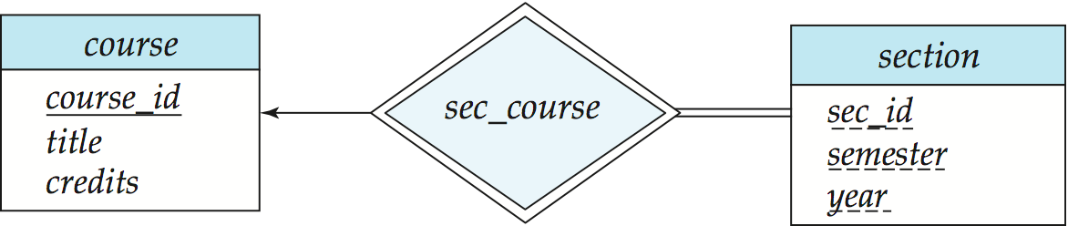
Weak Entity Sets (Cont.)
We underline the discriminator of a weak entity set with a dashed line.
We put the identifying relationship of a weak entity in a double diamond.
Primary key for section – (course_id, sec_id, semester, year)
Partial key/ Discriminator: Uniquely identifies a section among the set of sections of a particular course
Notes:
Weak Entity Set:
An entity set whose members owe their existence to some entity in a strong entity set.
􀂃entities are not of independent existence.
􀂃each weak entity is associated with some entity of the owner entity set through a special relationship.
􀂃weak entity set do not have a key attribute , may have discriminator

Slide 55
Weak Entity Sets (Cont.)
Section
Sec_Id | Semester | Year
A | I | 2021
B | I | 2021
A | III | 2020
B | III | 2020
A | II | 2020
B | II | 2020
A | IV | 2019
B | IV | 2019
A | I | 2019
A | III | 2018
… | .. | ..
Course
Course_Id | Title | Credits
MCA | Master of.. | 36
MTech | Info. Security | 38
MTech | S/W Engg | 36
Sec_Course
Notes:
Sec_Course

Slide 56
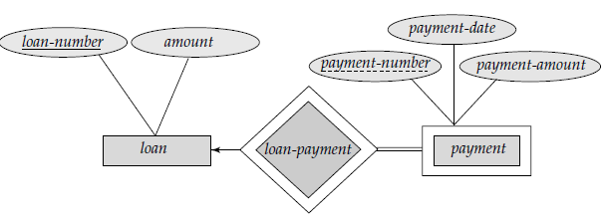
Weak Entity Sets (Cont.)
Note: the primary key of the strong entity set is not explicitly stored with the weak entity set, since it is implicit in the identifying relationship.
If course_id were explicitly stored, section could be made a strong entity, but then the relationship between section and course would be duplicated by an implicit relationship defined by the attribute course_id common to course and section.
Similar idea applies to loan, payment relations given below(how it is represented in scheme ?see next slide)-

Slide 57
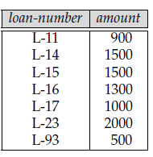
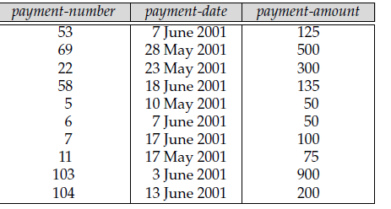
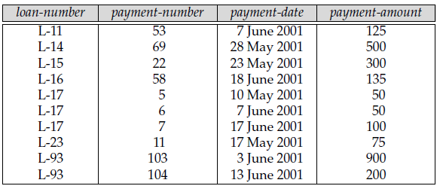
Loan-Payment
Loan Entity Type
Payment Entity Type – Weak Entity
Payment Entity Type can be Identified with respect Loan using PK of Loan
Notes:
Loan-Payment

Slide 58
Information to be fetched from Requirements
Entities
Strong
Attributes-Primary key, Composite/ Simple, Multivalued/Single valued, Derived.
Weak
Partial key
Relationship Between Entities
Relationship Attributes
Name of relationship
Cardinality Constraint
1-1, 1-M, M-M
Cardinality Limits
Participation
Total/Partial

Slide 59
Example
An Institute want to keep track of information about Funded Projects, Agencies which are Funding them and Faculties who work on those Projects.
The college is comprised of several departments such as – MCA,CS,IT ,MECH, EEE etc.. and each department has a Department Number such as D1,D2,.. used to identify each department. Many faculties work in every department . Each faculty is identified by a unique Employee Number. Information about each faculty we need is employee name, Qualification, Research-domain. Each Departments may have many funded research projects. Information about these projects such as an unique Project-ID, Title, Fund-Received, Duration. Each of these projects are funded by one or more funding agencies such as – MHRD,DSR, DST,BARC etc.. We also need to record information about Funded Funding agencies funding the projects such as- Grant_ord_No, Agency-Name, Contact-Person, Email, Phone, Total_Grant,Year-of-Grant. An agency may fund multiple project and a project may also receive grant from multiple agencies.
Model above data requirements using ER modeling.
Notes:
Example
Deptno, Dname, etc.

Slide 60
What are Entities here ?
What are attributes & sample entities here.
Deptno, Dname
Department
D1 | CS
D2 | IT
Empno, Ename, Qualification, Research-Domain
101 | Raj | MTech | Data-Mining
102 | Vinay | Mtech,PhD | Network Eng
106 | Manu | MCA, PhD | AI
Faculty
Project-ID, Title, Fund-Received, Duration
Projects
P1 | XYXX | 200K | 2
P2 | GHKL | 500K | 3
P3 | FGHK
Grant_order_No,Agency-Name, Contact-Person, Email,Phone,Total_Grant,Year-of-Grant
Agency
MH17-1 | MHRD | RamRao | ram@gmail.com | 78998667 | 2000K | 2017
MH18-5 | MHRD | Vijay | Vij@ymail.com | 89532689 | 5000K | 2018
DST17-3 | DST | Ravi | Ravi@gmail.com | 99644775 | 3500K | 2017
Notes:
Department – D1, CS ; D2, IT
Faculty- Empno, Ename, Qualification, Research-Domain
Projects- Project-ID, Title, Fund-Received, Duration
Agency-Agency-Name, Contact-Person, Email,Phone,Total_Grant,Year-of-Grant

Slide 61
Entities
PROJECT
Proj-ID Prj-Name Duration Fund_Received
DEPARTMENT
DeptNo DName
FACULTY
Empno Ename {Qualification} Research-Domain
AGENCY
Grant_Ord_No Agency_Name Contact-Person Email Phone Total_Grant Grant_Year
Notes:
Entities

Slide 62
Entities and Relationship
Empno Ename Qualification Research-Domain
Deptno, Dname
101 | Raj | MTech | Data-Mining
102 | Vinay | MTech,PhD | Network Eng
106 | Manu | MCA, PhD | AI
108 | Rakesh | MCA,MTech | SDN
D1 | CS
D2 | IT
D3 | EEE
1-Many
1-Many
Project-ID Title Fund-Received Duration
P1 | XYXX | 200K | 2
P2 | GHKL | 500K | 3
P3 | FGHK | 180K | 1.5
Many-Many
Grant_order_No,Agency-Name, Contact-Person, Email,Phone,Total_Grant,Year-of-Grant
MH17-1 | MHRD | RamRao | ram@gmail.com | 78998667 | 2000K | 2017
MH18-5 | MHRD | Vijay | Vij@ymail.com | 89532689 | 5000K | 2018
DST17-3 | DST | Ravi | Ravi@gmail.com | 99644775 | 3500K | 2017
Notes:
Entities and Relationship

Slide 63
Entities & Relationship
PROJECT
Proj-ID Prj-Name Duration Fund_Received
DEPARTMENT
DeptNo DName
Handles
Works_for
Granted_by
AGENCY
Grant_Ordr_No Agency_Name Contact-Person Email Phone Total_Grant Grant_Year
FACULTY
Empno Ename {Qualification} Research-Domain
Notes:
Entities

Slide 64
Example
Construct an E-R diagram for a car insurance company whose customers own one or more cars each. Each car has associated with it zero to any number of recorded accidents. Each insurance policy covers one car. (Identify the change needed in ER diagram if requirement is - Each insurance policy covers one or more cars), and has one or more premium payments associated with it. Each payment is for a particular period of time, and has an associated due date, and the date when the payment was received.
Notes:
Premium_Paid

Slide 65
Policy
Customer
Policy_Id
P1
P2
P3
Cust_Id | Name | Address
C1
C2
C3
Cars
License_No | Model
L1
L2
L3
Premium_Paid
Place | Date | Report_Id
MNG | D1 | R1
MNG | D1 | R2
UDP | D7 | R3
HYD | D3 | R4
Duration | Due_date | Amount | Received_on | Payment_no
2008 |  |  |  | Premium1
2009 |  |  |  | Premium2
2010 |  |  |  | Premium1
2010 |  |  |  | Premium1
Notes:
Customer , Policy. Cars,

Slide 66
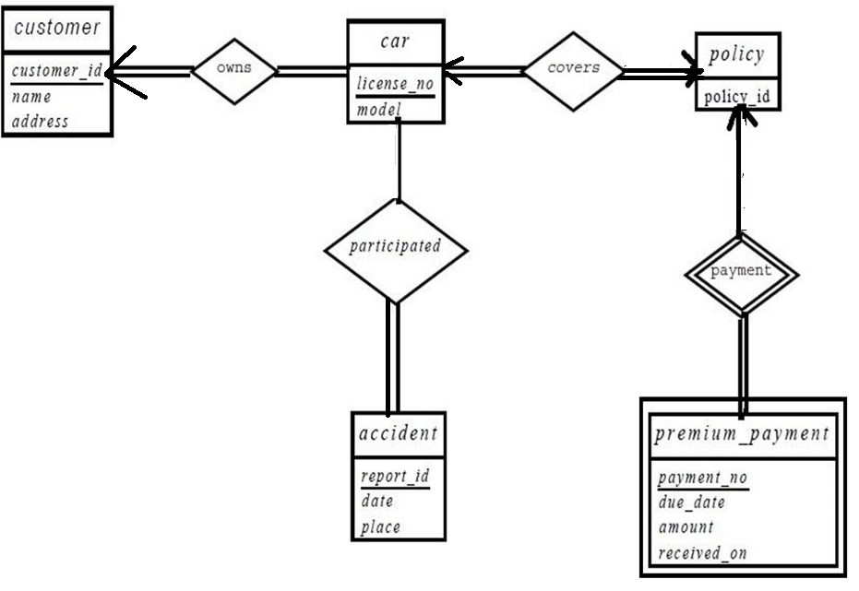
0..*

Slide 67
Reduction to Relational Schemas

Slide 68
Reduction to Relation Schemas
Entity sets and relationship sets can be expressed uniformly as relation schemas that represent the contents of the database.
A database which conforms to an E-R diagram can be represented by a collection of schemas.
For each entity set and relationship set there is a unique schema that is assigned the name of the corresponding entity set or relationship set.
Each schema has a number of columns (generally corresponding to attributes), which have unique names.

Slide 69

Representing Entity Sets With Simple Attributes
A strong entity set reduces to a schema with the same attributes Course(Course_ID, title, tot_cred)
A weak entity set becomes a table that includes a column for the primary key of the identifying strong entity set. section ( course_id, sec_id, sem, year )
Note: schemas sec_course(course_id, sec_id, sem, year ) is not represented because sec_course schema is redundant in Section (course_id, sec_id, sem, year) schema
Notes:
A relationship set linking a weak entity set to the corresponding strong entity set is treated specially.
The primary key of a weak entity set includes the primary key of the strong entity set.
Course(Course_ID, title, tot_cred) & section ( course_id, sec_id, sem, year)
In the case of the
entity set section, its primary key is {course id, sec id, year, semester}, where course
id is the primary key of the identifying entity set, namely course, and {sec id, year,
semester} Partial Key distinguishes section entities for the same course.
You may wonder why we have not seen the schemas sec_course(course_id, sec_id, sem, year ) .
Every (course id, sec id, semester,year) combination in a sec course relation would also be present in the relation on
schema section, and vice versa. Thus, the sec_course schema is redundant.
Note that, a schema is not represented for the relationship sec_course as sec_course(course_id, sec_id, sem, year ) because it is redundant in section ( course_id, sec_id, sem, year )

Slide 70
Redundancy in Schema Representation
The schema corresponding to a relationship set linking a weak entity set to its identifying strong entity set is redundant.
Example: The section schema already contains the attributes that would appear in the sec_course schema
Notes:
Redundancy in Schema Representation

Slide 71

Representing Relationship Sets Many-Many
A many-to-many relationship set is represented as a schema with attributes for the primary keys of the two participating entity sets, and any descriptive attributes of the relationship set.
Example: schema for relationship set advisor
advisor (S_ID, I_ID)
Instructor( ID, Name, Salary) & Student(ID, Name, tot_cred)

Slide 72
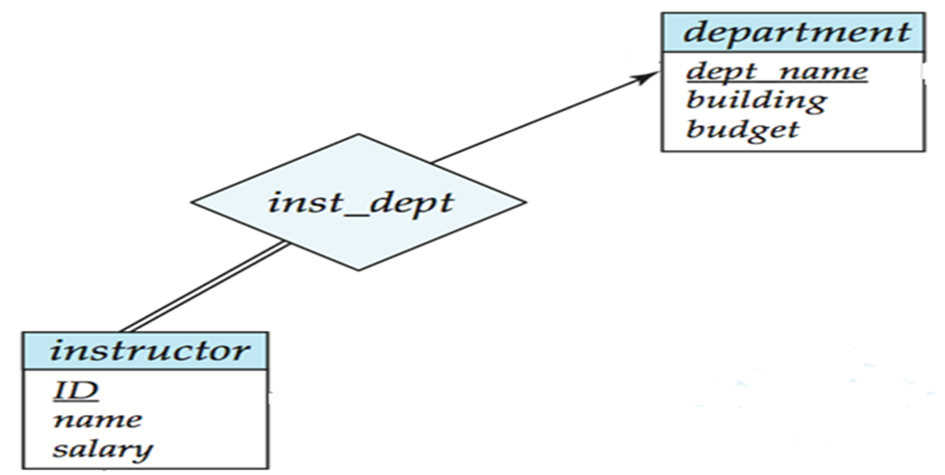
Representing Relationship sets- Many-1/1-Many
Many-to-one and one-to-many relationship sets that are total on the many-side can be represented by adding an extra attribute to the “many” side, containing the primary key of the “one” side
Example: Instead of creating a schema for relationship set inst_dept, add an attribute dept_name to the schema arising from entity set instructor
Instructor( ID, Name, Salary, Dept_Name)
Department(Dept_Name, Building, Budget)
Dept_Name in Instructor is taken as Foreign key referencing Department.
Notes:
Instructor( ID, Name, Salary, Dept_Name)
Department(Dept_Name, Building, Budget)
Dept_Name in Instructor is taken as Forign key referencing Department.
If participation is partial on the “many” side, replacing a schema by an extra attribute in the schema corresponding to the “many” side could result in null values

Slide 73
Representing Relationship sets- 1 to 1
For one-to-one relationship sets, either side P.key can be chosen to act as F.key at other side
HOI_Name
Qualification
Ints__name
Budget
Work_for
Institute-Head
Institutes
Institute_Head(HOI_Name, Qualification )
Institute(Inst_Name,Budget, HOI_Name)
HOI_Name in Institute is taken as Foreign key referencing Institute_Head.
Notes:
Institute_Head(HOI_Name, Qualification )
Institute(Inst_Name,Budget, HOI_Name)
HOI_Name in Institute is taken as Foreign key referencing Institute.

Slide 74
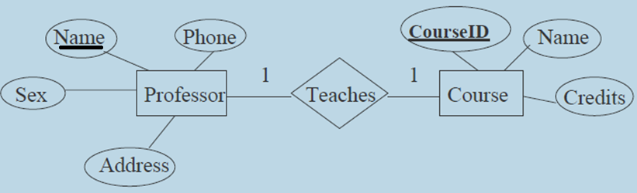
Reduce the Following ER Diagrams into Relational Schema.
Professor(Name, Phone, Address, Sex, CourseID)
Course(CourseId, Name, Credits)
Professor.CourseID is foreign key referencing Course.CourseID

Slide 75
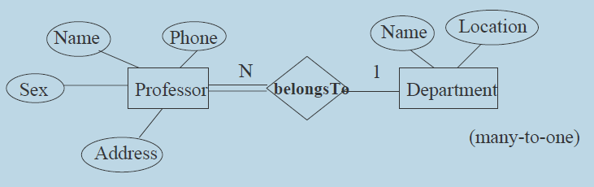
Reduce the Following ER Diagrams into Relational Schema.
Requirement collected says-A department contains many Professor
Professor(Name, Phone, Address, Sex, Dep_Name)
Department(Name, Location)
Dep_Name is foreign key referencing Department. Name
Notes:
Reduce the Following ER Diagrams into Relational Schema.
Assume Attributes for the
A department contains many Professor

Slide 76
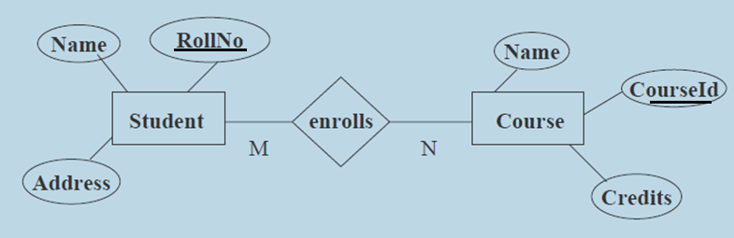
Reduce the Following ER Diagrams into Relational Schema.
Assume, Requirement says- A course is enrolled by multiple students and a student may also enroll to multiple course
Assume Student.Rollno and Course. CourseId is Primary Key in Student and Course entity types respectively.
Student(Name, RollNo, Address)
Course(Name, CourseId, Credits)
Enrolls(RollN,CourseId)
Notes:
Assume Student.Name and Course.Name is Primary Key in Student and Course entity types respectively.
Student(Name, RollNo, Address)
Course(Name,CourseId, Credits)
Requiremet says- A course is enrolled by multiple students and a student may also enroll to multiple course

Slide 77
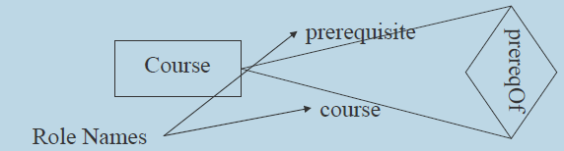
Reduce the Following ER Diagrams into Relational Schema.- Recursive Relationship
Assume that the Prerequisite for a Couse is another Course.
Assume COURSE has attributes CourseId, Course_name, Credits
Course(CourseId, Course_Name, Credits, Pre_CourseId)
Note: It is recursive relationship
Pre_CourseId (F.key) Referencing CourseId (P.Key)
Notes:
A Couse has a Prerequisite Course

Slide 78
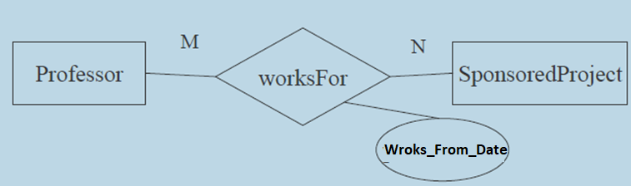
Reduce the Following ER Diagrams into Relational Schema –with Descriptive Attribute
Assume Professor has attributes – Empno, Name ,Address
and SponseredProject has attributes – Prj_Id, Pname, Duration)
Professors start working on different project from different dates
Professor(Empno, Name ,Address)
SponseredProject(Prj_Id, Name, Duration)
Works_for(Empno, Prj_Id, Works_From_Date)
Notes:
A relationship instance in a given relationship set must be uniquely identifiable from its participating entities, without using the descriptive attributes.
Assume Professor has attributes – Empno, Name ,Address
Assume SponseredProject has attributes – Prj_Id, Pname)
Assume professors may work on multiple projects with varying amount of time(10% of time on project-1 and 30% on Proj-2 etc.)

Slide 79
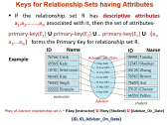
Reduce the Following ER Diagrams into Relational Schema –with Descriptive Attribute
Assume the requirement is- many Instructors can be advisor to multiple students at different dates.
Date_of_advisor
Instructor(ID, name, Salary)
Student(ID, name, tot_cred)
Advisor(I.Id, S.Id, Date_of_advisor)
Notes:
Instructor(ID,name,Salary)
Student(ID,name,tot_cred)
Assume the requirement is- Instructor can be advisor to multiple students at different dates.
A relationship instance in a given relationship set must be uniquely identifiable from its participating entities, without using the descriptive attributes.
The cardinality ratio of a relationship can affect the placement of relationship attributes. Thus, attributes of one-to-one or one-to-many relationship sets can be
associated with one of the participating entity sets, rather than with the relationship set. For instance, let us specify that advisor is a one-to-many relationship set
such that one instructor may advise several students, but each student can be advised by only a single instructor. In this case, the attribute date, which specifies
when the instructor became the advisor of a student, could be associated with the student entity set

Slide 80
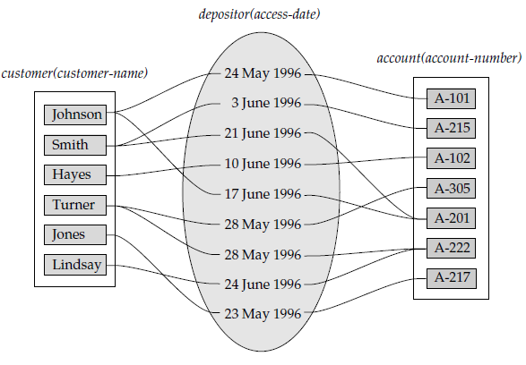
Relation –with Descriptive Attribute
Customer and Account are having many-to-many relationship
and the access _date descriptive attribute attached to the relationship set depositor to specify the most recent date on which a customer accessed that account.
However if we want to record all dates when customers have accessed their accounts then scenario will be different while converting into schema.
In that case relationships like –
(Smith,21-June-1996,A-201) and (Smith,21-June-1996,A-215) may exist
Notes:
Customer and Account are having many-to-many relationship(a customer can have multiple account and an account may be jointly manged by multiple customers)
and the access _date descriptive attribute attached to the relationship set depositor to specify the most recent date on which a customer accessed that account.

Slide 81
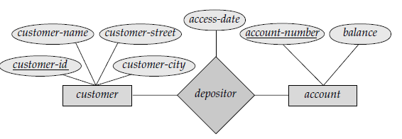
ER Diagram & SChema –with Descriptive Attribute
Customer(CustomerID,…);
Account(Account_Number, Balance)
Depositor(Account_Number,CustomerID,Access_Date)
However if we want to record all dates when customers have accessed their accounts then scenario will be different while converting into schema.
In that case relationships like –
(Smith,21-June-1996,A-201) and (Smith,21-June-1996,A-215) may exist.
Now Access_Date also will be part of Primary key
Customer(CustomerID,…);
Account(Account_Number, Balance)
Depositor(Account_Number, CustomerID, Access_Date)
Notes:
Customer(CustomerID,…);
Account(Account_Number, Balance)
Depositor(Account_Number,CustomerID,Access_Date)

Slide 82
Reduce the Following ER Diagrams into Relational Schema- Weak Entity.
EName
Depnd_Name
Relationship_with
Empno
Med-Dependents
Employee
Medicare_Dependents
Employee(Empno,Ename)
Medicare_Dependents(Empno,Depnd_Name, Relationship_with)
Empno in Medicare_Dependets is Foreign key Referencing Empno in Employee.
Notes:
Employee(Empno,Ename)
Medicare_Dependents( Depnd_Name,RelatedAs)

Slide 83
Representing Composite Attributes in Schema
Composite attributes are flattened out by creating a separate attribute for each component attribute
Example: given entity set instructor with composite attribute name with component attributes first_name and last_name the schema corresponding to the entity set has two attributes name_first_name and name_last_name
Prefix omitted if there is no ambiguity.
instructor schema is
Instructor ( ID, first_name, middle_initial, last_name, street_number, street_name, apt_number, city, state, zip_code, date_of_birth)
Notes:
83

Slide 84
Representing Multivalued Attributes in Schema
A multivalued attribute M of an entity E is represented by a separate schema EM
Schema EM has attributes corresponding to the primary key of E and an attribute corresponding to multivalued attribute M
Example: Multivalued attribute phone_number of instructor is represented by a schema: inst_phone ( ID, phone_number)
Each value of the multivalued attribute maps to a separate tuple of the relation on schema EM
For example, an instructor entity with primary key 22222 and phone numbers 456-7890 and 123-4567 maps to two tuples(multi valued): (22222, 456-7890) and (22222, 123-4567)
Notes:
84

Slide 85
Extended E-R Features

Slide 86
Extended E-R Features: Specialization
Specialization is a Top-down design process in which we designate subgroupings within an entity set.
These subgroupings become lower-level entity sets that have attributes that do not apply to the higher-level entity set.
Attribute inheritance – A lower-level entity set inherits all the attributes and relationship participation of the higher-level entity set to which it is linked.
Depicted by a triangle component labeled ISA
(E.g. instructor “is a” person).
It can also be referred as a superclass-subclass relationship
Notes:
86
If MU_EMPLOYEE is an Entity set , in this we can have two distinctive sub-group of entities TEACHING and NON-TEACHING.
TEACHING and NON-TEACHING have some attributes that do not apply to MU_EMPLOYEE and TEACHING , NON-TEACHING
entities may be participating in different relationship than MU_EMPLOYEE participates.
TEACHING and NON-TEACHING may be inheriting some attributes of MU_EMPLOYEE
The refinement from an initial entity set into successive levels of entity subgroupings represents a top-down design process in which distinctions are made explicit.
The design process may also proceed in a bottom-up manner, in which multiple
entity sets are synthesized into a higher-level entity set on the basis of common
features.

Slide 87
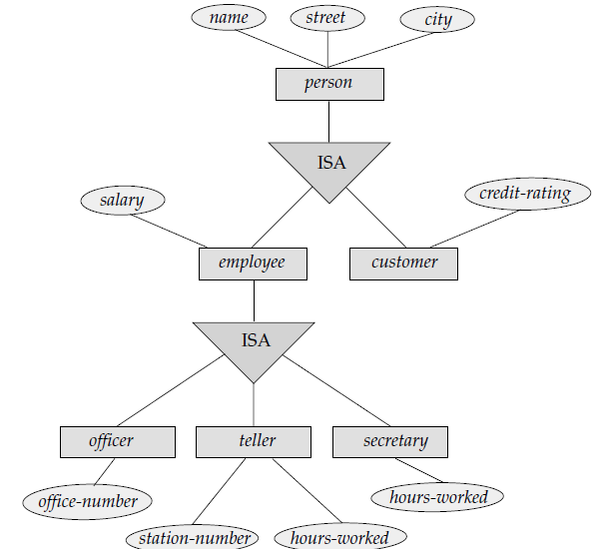
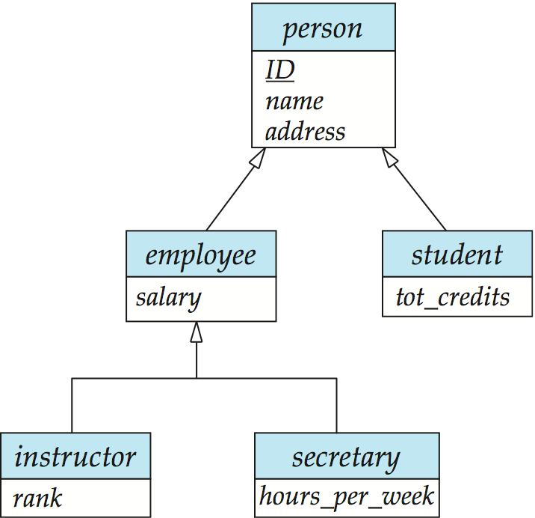
Specialization / Generalization Example
(6th Edition)
(4th Edition)
Notes:
87
New(6th Edition) and old (4th,5th Editions) conventions to represent Specialization.
Whether a given portion of an E-R model was arrived at by specialization or generalization,
the outcome is basically the same:
• A higher-level entity set with attributes and relationships that apply to all of its lower-level entity sets.
Specialization stems from a single entity set; it emphasizes differences among entities within the set by creating distinct lower-level entity sets.
• Lower-level entity sets with distinctive features that apply only within a particular lower-level entity set.
Generalization proceeds from the recognition that a number of entity sets share some common features . . On the basis of their commonalities, generalization synthesizes higher level entity set. Generalization is used to emphasize the similarities among lower-level entity sets and to hide the differences;

Slide 88
Design Constraints on a Specialization/ Generalization
Constraint on whether or not entities may belong to more than one lower-level entity set within a single generalization.
Disjoint
An higher level entity can belong to only one lower-level entity set
Noted in E-R diagram by having multiple lower-level entity sets link to the same triangle see Accounts , Savings and Checking entities in next slide.
Overlapping
an entity can belong to more than one lower-level entity set.
In a Person Entity set is Specialized into Sub classes- Student entity set & Teaching_Assistants.
–Some persons are student only and some persons may be students as well as Teaching Assistants
Notes:
88
Condition-defined. lower-level entity sets, membership is evaluated on the basis of whether or not an entity satisfies an explicit condition
or predicate.
User-defined. User-defined lower-level entity sets are not constrained by a
membership condition; rather, the database user assigns entities to a given entity
set.
A given employee is not assigned to a specific team entity automatically on the
basis of an explicit defining condition. Instead, the user in charge of this decision
makes the team assignment on an individual basis. The assignment is
implemented by an operation that adds an entity to an entity set.

Slide 89
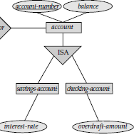
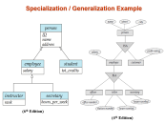
Design Constraints on a Specialization/Generalization (Cont.)
Completeness constraint - specifies whether or not an entity in the higher-level entity set must belong to at least one of the lower-level entity sets within a generalization.
total : an entity must belong to one of the lower-level entity sets
Account either have to be savings or checking account
partial: Some higher-level entities may not belong to any lower-level entity set..
Assume that, after 3 months(or may be after passing some qualifying exam) of employment, bank employees are assigned to one of four work teams. Therefore before 3 months there will be some employee entities in the top not belonging to any work team lower entities.
disjoint
Notes:
89

Slide 90
Representing Specialization via Schemas
Method 1:
Form a schema for the higher-level entity
Form a schema for each lower-level entity sets, include primary key of higher-level entity set and local attributes schema attributes person ID, name, street, city student ID, tot_cred employee ID, salary
Drawback: getting information about, an employee requires accessing two relations, the one corresponding to the low-level schema(employee) and the one corresponding to the high-level schema(person)
Notes:
90

Slide 91
Representing Specialization as Schemas (Cont.)
Method 2:
Form a schema for each entity set with all local and inherited attributes schema attributes student ID, name, street, city, tot_cred employee ID, name, street, city, salary
If specialization is total, the schema for the generalized entity set (person) not required to store information
Can be defined as a “view” relation containing union of specialization relations
Drawback: name, street and city may be stored redundantly for people who are both students and employees
Notes:
91
But explicit schema may still be needed for foreign key constraints

Slide 92
Draw an ER diagram for the following Requirements
Consider a Banking system, which stores information about it’s different branches at different locations. Each branch has a unique branch name, location and assets (in Rupees).
Each branch maintains many Savings accounts of different customers. System is interested to record SB account number and balance amount of each savings account.
Each customer may have many accounts and an account may be owned jointly by multiple Customers. Customer information such as-unique Customer_Name, city and street need to be stored in the system.
Each branch also gives loans to customers. About Loans we are interested to store information such as unique loan_number, Loan_amount. Each branch maintains many loan accounts. Each customer is allowed to take many loans and at the same time a loan may be jointly taken by many Customer.

Slide 93
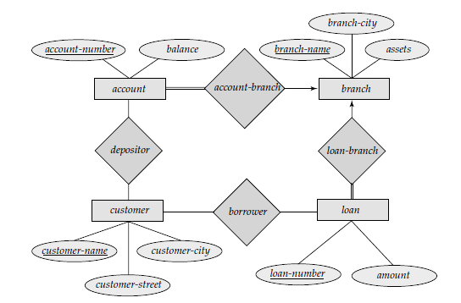
The relational schema corresponding to this ER diagram is below-
Account(account-number, balance, branch-name) branch-name References Branch
Branch(branch-name, branch-city, assets)
Loan(loan-number, amount, branch-name) branch-name References Branch
Customer(customer-name, customer-city, customer-street)
Borrower(customer-name,loan-number) customer-name References Customer & loan-number References Loan.
Depositor(account-number,customer-name) account-number References Account, customer-name References Customer

Slide 94
Schema Diagrams
A database schema, along with primary key and foreign key dependencies, can be depicted by schema diagrams.
Each relation appears as a box, with the relation name at the top in box, and the attributes listed inside the box. Primary key attributes are shown underlined. Foreign key dependencies appear as arrows from the foreign key attributes of the referencing relation to the primary key of the referenced relation.
Schema diagram corresponding to Relational schema is given in the next slide.
Notes:
A database schema, along with primary key and foreign key dependencies, can be depicted by schema diagrams.
Consider a Banking system, which stores information about it’s different branches at different locations. Each branch has a unique branch name, location and some amount as assets. Each branch maintains many Savings accounts of different customers. System is interested to record SB account number and balance amount of each savings account. Each customer may have many accounts and an account may be owned jointly by multiple Customers. Customer information such as-unique Customer_Name, city and street need to be stored in the system. Each branch also gives loans to customers. About Loans we are interested to store information such as unique loan_number, Loan_amount. Each branch maintains many loan accounts. Each customer is allowed to take many loans and at the same time a loan may be jointly taken by many Customer.

Slide 95
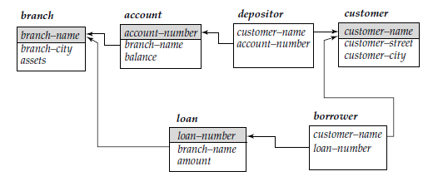
Relational Schema & Schema Diagram
Account(account-number, balance, branch-name) branch-name References Branch
Branch(branch-name, branch-city, assets)
Loan(loan-number, amount, branch-name) branch-name References Branch
Customer(customer-name, customer-city, customer-street)
Borrower(customer-name,loan-number) customer-name References Customer & loan-number References Loan.
Depositor(account-number,customer-name) account-number References Account, customer-name References Customer
Schema Diagram
Notes:
Relational Schema & Schema Diagram

Slide 96
Oracle SQL Commands Corresponding to Relational schema given in Previous Slide(For Lab implementation)
CREATE TABLE BRANCH (BRANCH-NAME VARCHAR2(15) PRIMARY KEY, BRANCH-CITY VARCHAR2(20), ASSETS NUMBER(10,2));
CREATE ACCOUNT (ACCOUNT-NUMBER VARCHAR2 (3) PRIMARY KEY, BALANCE NUMBER(8,2) CHECK(BALANCE >1000), BRANCH-NAME VARCHAR2(15) NOT NULL REFERENCES BRANCH)
CREATE TABLE LOAN(LOAN-NUMBER VARCHAR2(3) PRIMARY KEY, AMOUNT NUMBER(5,1), BRANCH-NAME VARCHAR2(15) REFERENCES BRANCH)
CREATE TABLE CUSTOMER (CUSTOMER-NAME VARCHAR2(10) PRIMARY KEY, CUSTOMER-CITY VARCHAR2(110),CUSTOMER-STREET VARCHAR2(120))
CREATE TABLE BORROWER (CUSTOMER-NAME VARCHAR2(10) REFERENCES CUSTOMER,LOAN-NUMBER VARCHAR2(3) REFERENCES LOAN, PRIMARY KEY(CUSTOMER-NAME, LOAN-NUMBER));
CREATE TABLE DEPOSITOR (ACCOUNT-NUMBER VARCHAR2 (3) REFERENCES ACCOUNT,CUSTOMER-NAME VARCHAR2(10) REFERENCES CUSTOMER), PRIMARY KEY(CUSTOMER-NAME, ACCOUNT-NUMBER));
Notes:
SQL Commands Corresponding to Relational schema given in Previous Slide-For Lab implementation

Slide 97
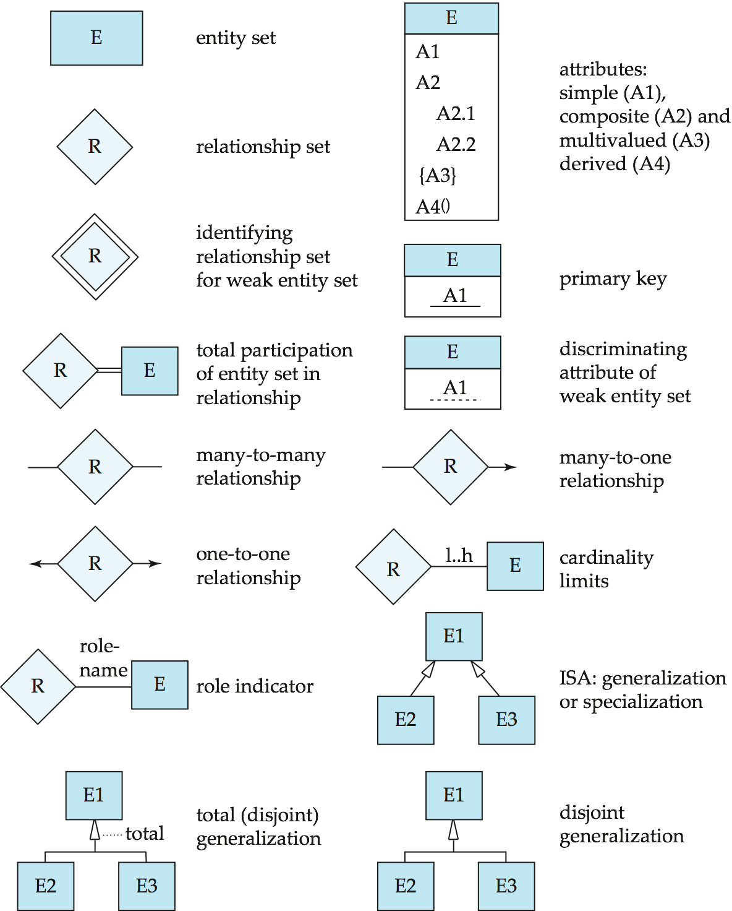
Summary of Symbols Used in E-R Notation
Notes:
97

Slide 98
Symbols Used in E-R Notation (Cont.)
Notes:
98

Slide 99
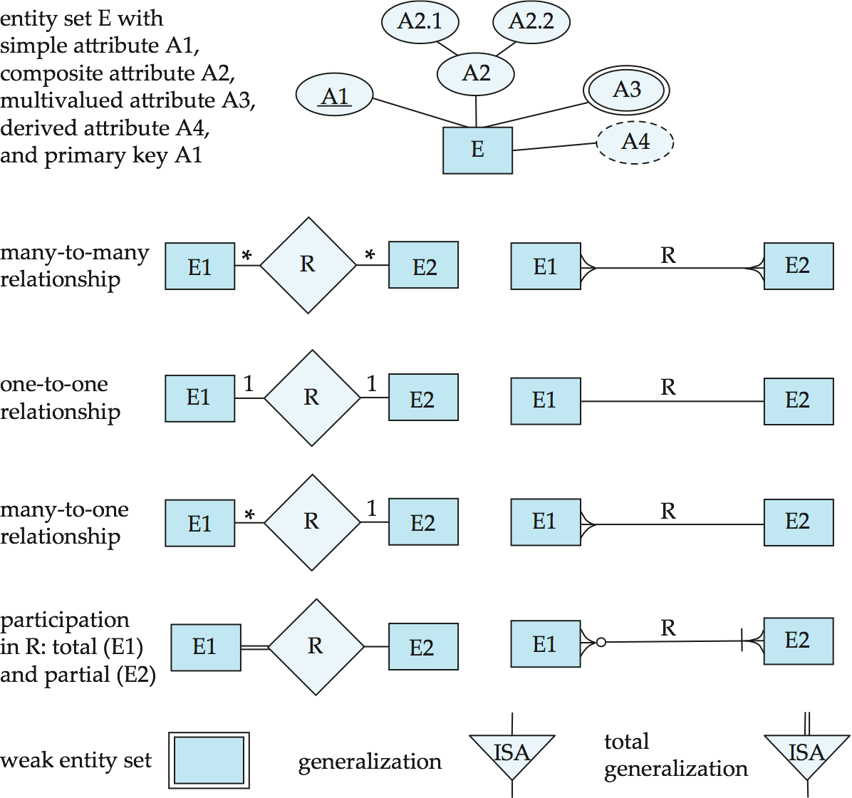
Alternative ER Notations
Chen, IDE1FX, …
Notes:
99

Slide 100
Alternative ER Notations
Chen IDE1FX (Crows feet notation)
Notes:
100

Slide 101
Summary
• A database-management system (DBMS) consists of a collection of interrelated data.
Database design mainly involves the design of the database schema. The entity-relationship (E-R) data model is a widely used data model for database design.
An entity is an object that exists in the real world and is distinguishable from
other objects by the properties(attributes) it is having.
A relationship is an association among several entities. A relationship set is a collection of relationships of the same type, and an entity set is a collection of entities of the same type.
The terms super key, candidate key, and primary key apply to entity and relationship sets as they do for relation schemas.
Mapping cardinalities express the number of entities to which another entity
can be associated via a relationship set.
• An entity set that does not have sufficient attributes to form a primary key is termed
a weak entity set. An entity set that has a primary key is termed a strong entity set.
Specialization and generalization define a containment relationship between
a higher-level entity set and one or more lower-level entity sets.
Notes:
Ternary relationship and representing equivalently using Binary relations by introducing an entity

Slide 102
Some Questions
Explain the difference between a weak and a strong entity set.
Explain the distinctions among the terms primary key, candidate key, and super key with an example.
A weak entity set can always be made into a strong entity set by adding to its attributes the primary-key attributes of its identifying entity set. Outline what sort of redundancy will result if we also take into account of cardinality also while converting to schema.
Is an weak entity has to have Total Participation ?
Construct an E-R diagram for a car-insurance company whose customers own one or more cars each. Each car has associated with it zero to any number of recorded accidents.
Notes:
Some Questions

Slide 103
ER MODEL
END OF CHAPTER

